Slide 1

Car & Care
Car Rental Company
Car Rental System
BY
Omar Akbar
Jaykumar Ahir
Javid Niftaliyev
Aslan Mirsakiyev

Slide 2
Software Development Lifecycle
Vision
Benefits
Capabilities
Subsystems
Preliminary
Phase
Use Case & Users Stories
Domain Class Diagram
System Sequence Diagram
Activity Diagrams
Analysis
Phase
CRC
Design Class Diagram
Sequence Diagram
State Diagram
ER Diagram
UI Design
System Architecture
Implementation
Phase
Design
Phase

Slide 3
Car & Care Vision
Problem:
Car & Care is a new car rental company that is missing the basic IT infrastructure to manage new operations such as booking, registration, quotation, payment, supply and check-out. As the company is in early phase, it wants to attract new customers and streamline transactions.
Needs:
The company needs a web application that manages the company main activities and allow customers, employees, managements to share information and handle all transactions related to the business.

Slide 4
Business Benefits
Streamline the car rental process and help in expanding Car & Care operation
Generate a cohesive and efficient business environment where customers, employees and managers are all integrated under the same umbrella
Optimize IT investments and achieve a faster ROI without significant overhead
Enhance business relations between the company and its customers though a tight and automated feedback system
Empower managers with proper reporting system to enhance decision making process
Ensure all company’s operations are governed by same standards and regulations

Slide 5
System Capabilities
Capture and maintain company’s assets
Handle all major business transactions
Provide a customer-oriented user interface for booking management
Offer statistical reports about sales, bookings, accidents, feedbacks and vehicles performance
Allow users’ feedbacks and ratings
Provide a back-end admiration capability to manage inventories, bookings, users and backup/restore
Offer a detailed search engine for inventory and company’s resources
Provide a single-point-of-access for all company’s activities from front counter control to back office management.
Access business information and resources from anywhere

Slide 6
Main Subsystems
Total Vision
Inventory Management
Rate Management
Booking
Cancellation
Registration
Check-out
Check-in
Login
Payment
Review/Feedback
Reports
Claims
Loyalty Management
Phase One Scope
Booking
Cancellation
Check-out
Login
Reports

Slide 7
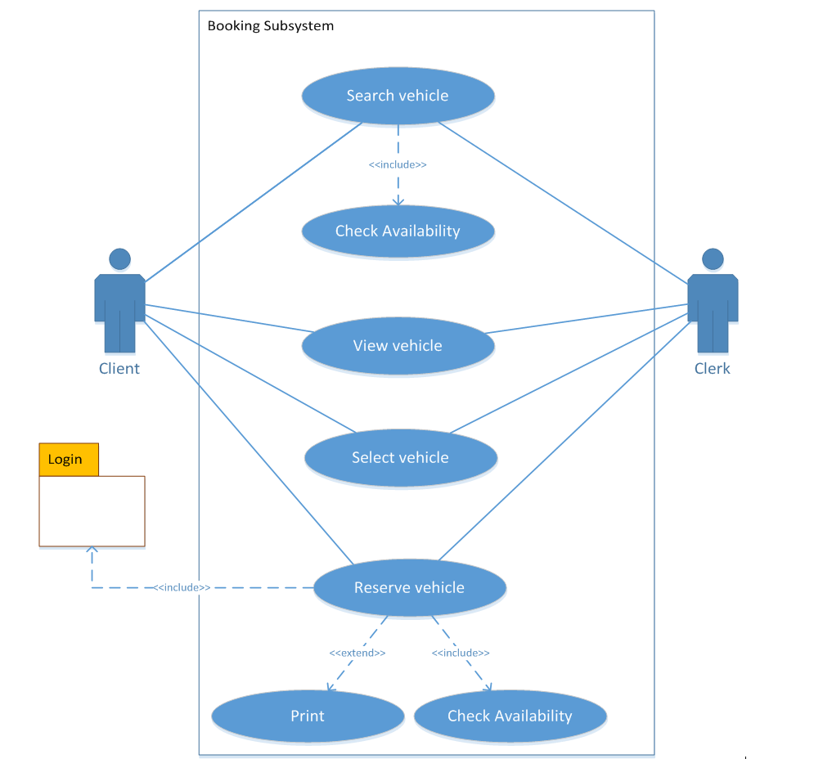
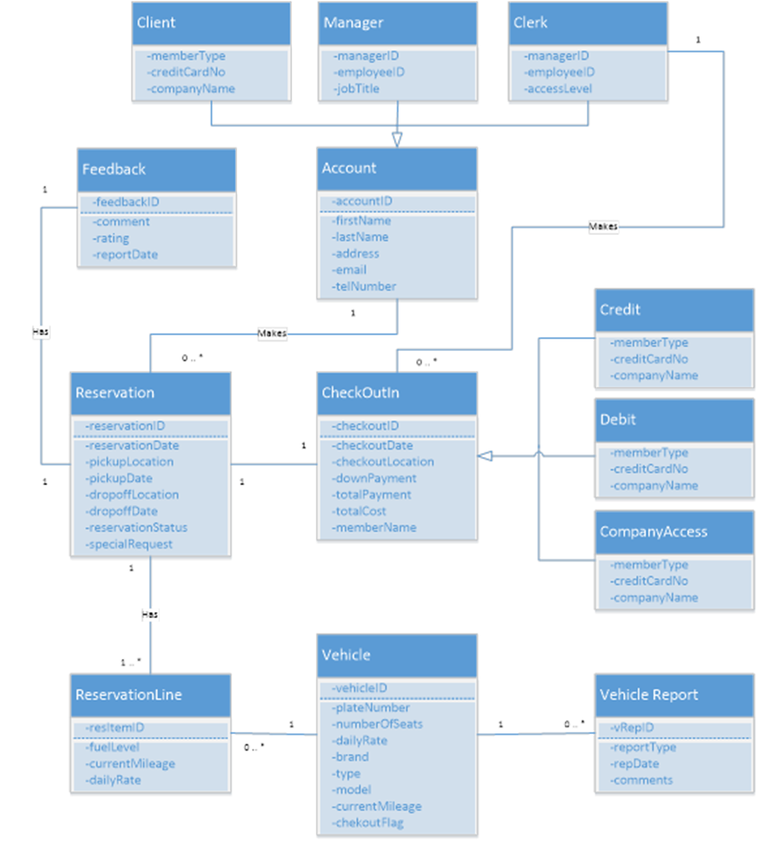
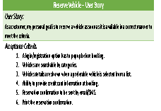


Use Case & Users Stories
Reserve Vehicle – User Story
User Story: As a customer, my personal goal is to reserve a vehicle as soon as it is available in a correct manner to meet the criteria.
Acceptance Criteria: A login/registration option has to popup before booking. Vehicles are searchable by categories. Vehicles details are shown when a preferable vehicle is selected from a list. Ability to provide credit card information at booking. Reservation confirmation to be sent by email/SMS. Print the reservation confirmation.
Business
Challenge

Slide 8
Domain Class Diagram
Define the
Things?

Slide 9
Class Responsibility Collaborator
Methods
CRUD
Subsystem | Class | Responsibility | Collaborator
Login | Account | Access Account | Client, Clerk, Manager
Booking | Reservation | Make Reservation | ReservationLine
 |  | View Reservation
 |  | Get Reservation Items
 | ReservationLine | Create Reservation Item | Reservation, Vehicle
 |  | View Reservation Item
 | Vehicle | View Vehicle Details | ReservationLine
Cancellation | Reservation | Cancel Reservation | ReservationLine
 | ReservationLine | Delete Reservation Item | Reservation
Checkout | Reservation | View Reservation | ReservationLine
 |  | Get Reservation Items
 | CheckOutIn | Checkout Vehicle | Reservation, Vehicle, Credit, Debit, CompanyAccess
 |  | Update Checkout Info
 | Vehicle | Update Checkout Flag | CheckOutIn
 | ReservationLine | View Reservation Item | Reservation, Vehicle
Report | CheckOutIn | Generate Sale Report
 | Reservation | Generate Booking Report | ReservationLine, Vehicle
 | VehicleReport | Generate Accident Report | Vehicle
 | Vehicle | Generate Vehicle Performance Report | ReservationLine, VehicleReport
 | Feedback | Generate Feedback Report | Reservation, Account
Subsystems
Related Classes
Classes

Slide 10
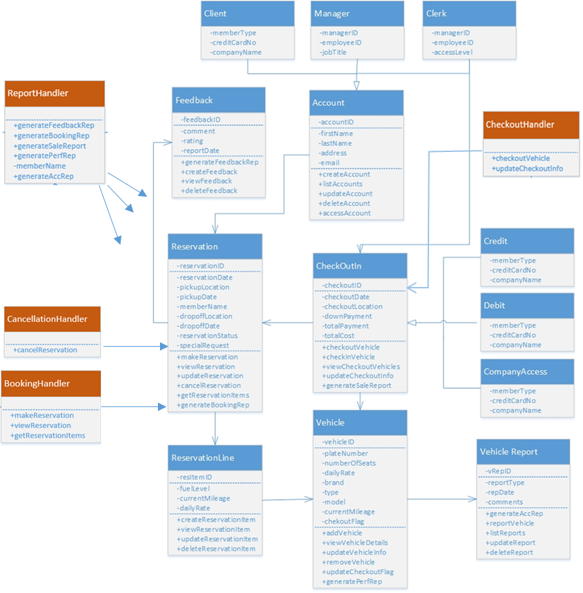
Design Class Diagram
Controllers
Methods

Slide 11
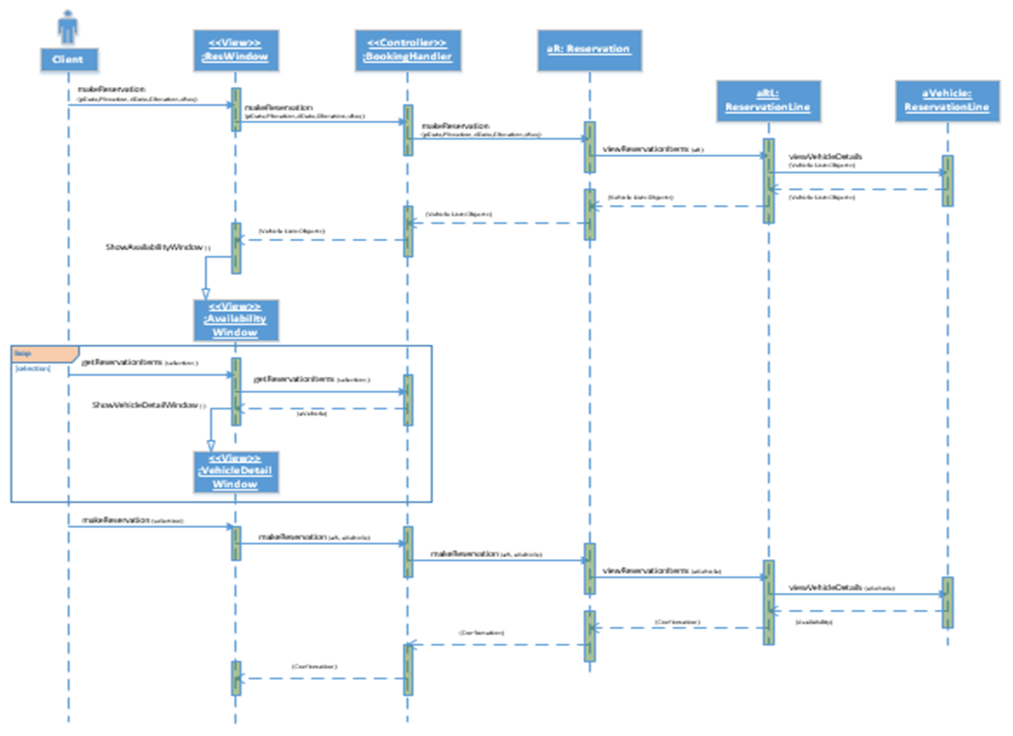
Sequence Diagram
Actors
Viewers
Controllers
Classes
Loops
Messages
(methods)

Slide 12
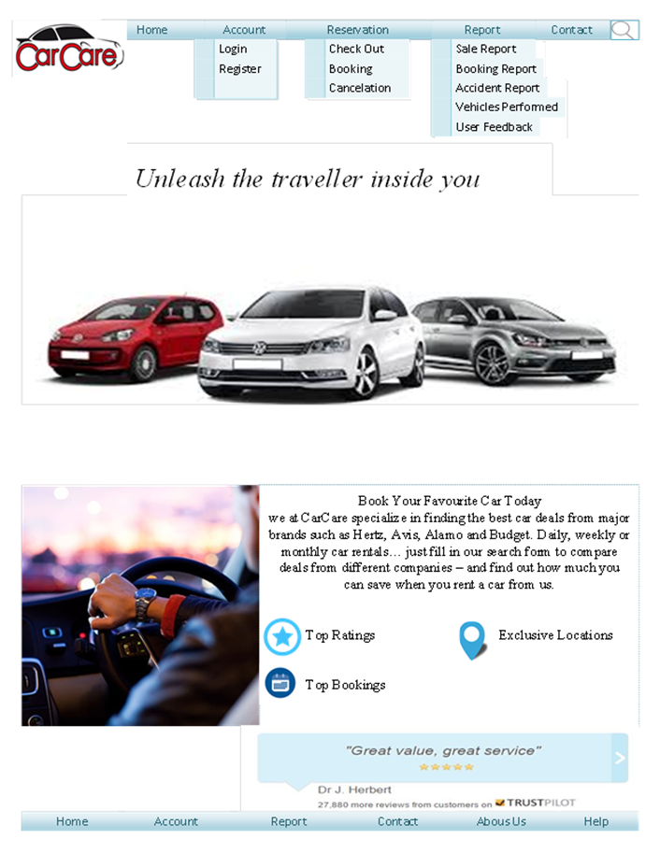
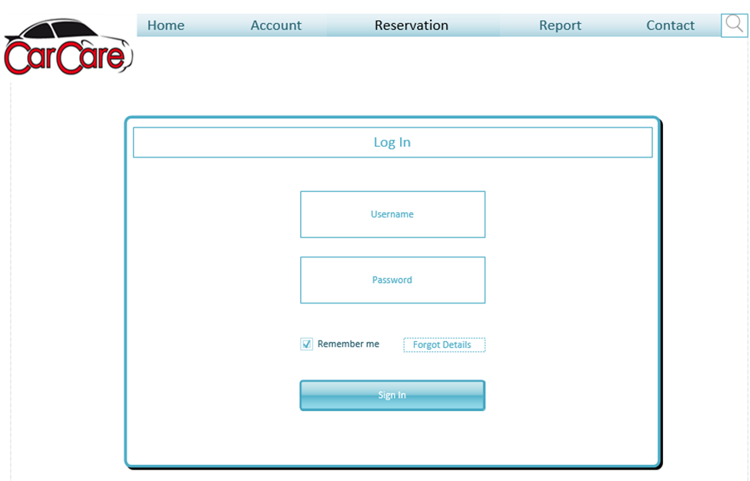
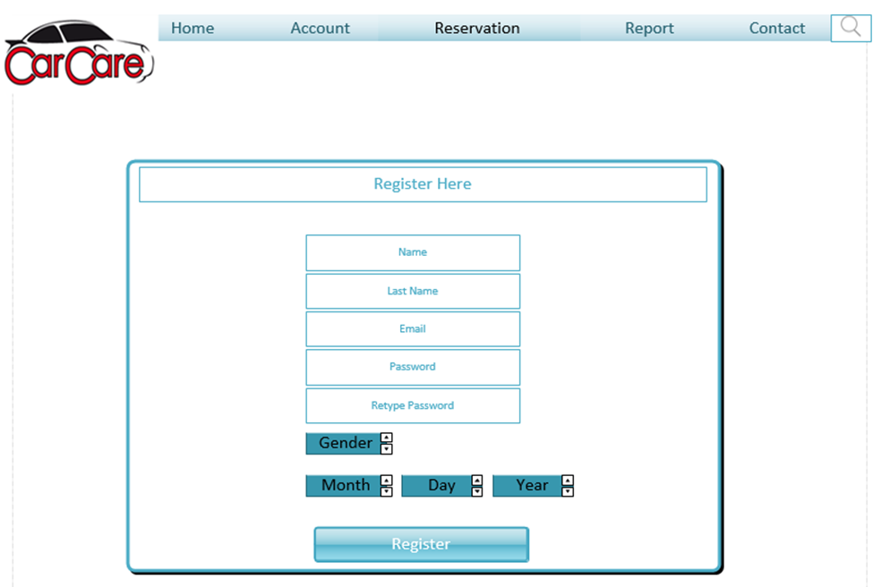
Mock-up UI
Login
Registration

Slide 13
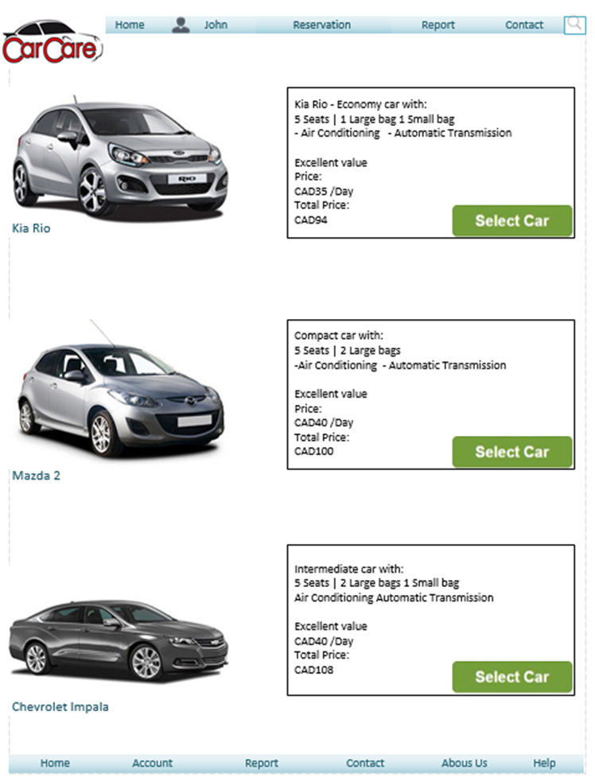
Mock-up UI
Reservation

Slide 14
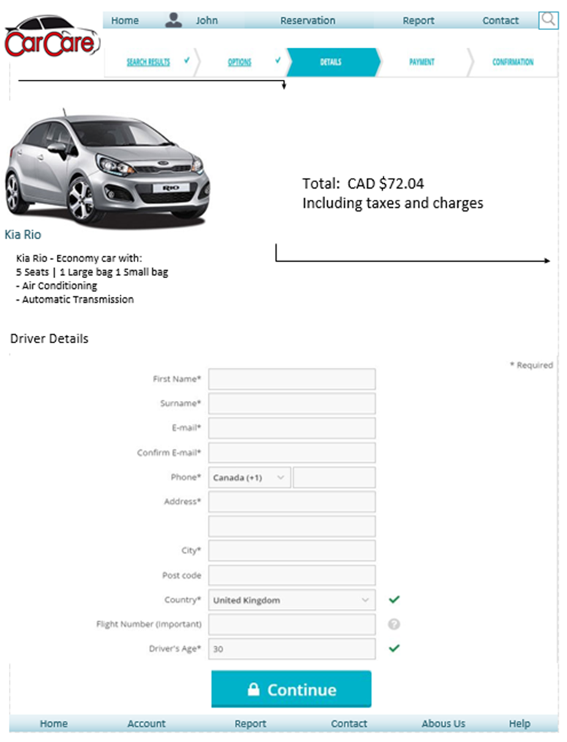
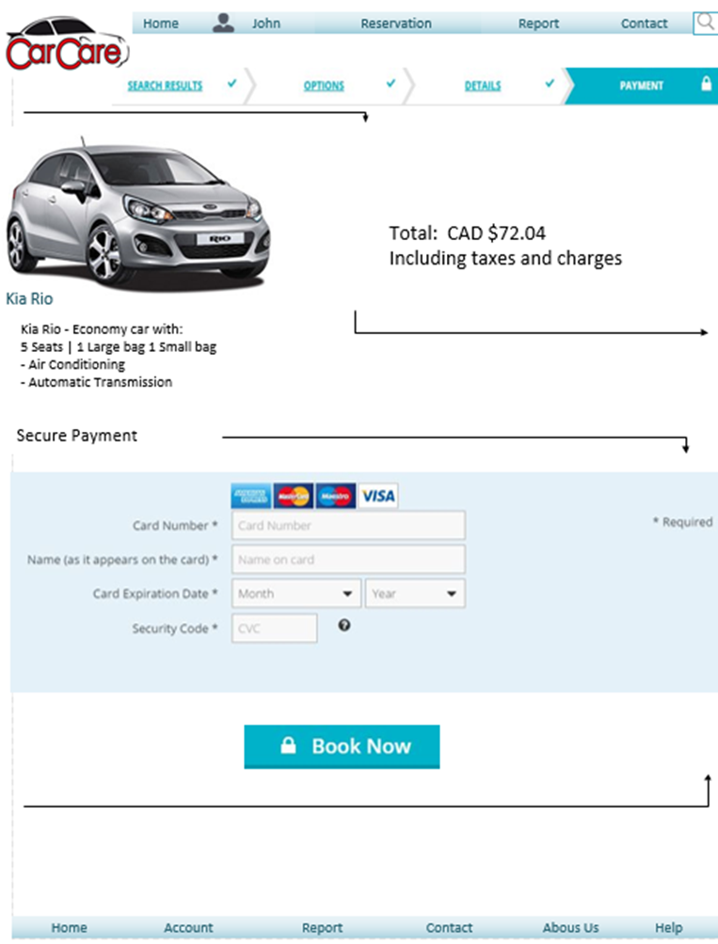
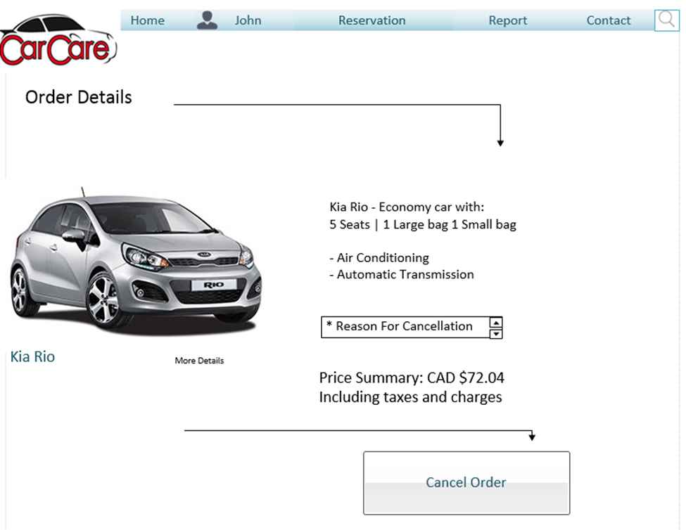
Mock-up UI
Checkout
Payment
Cancelation

Slide 15
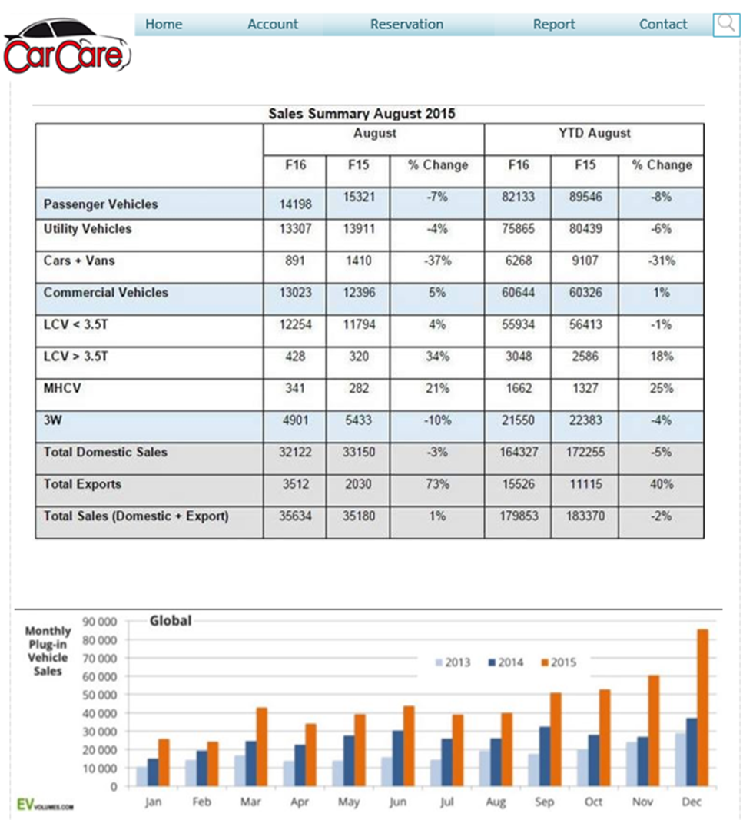
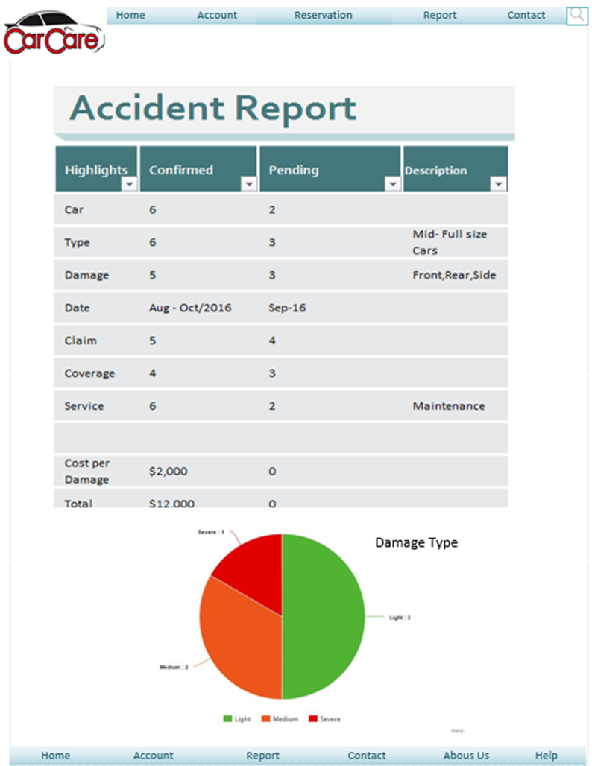
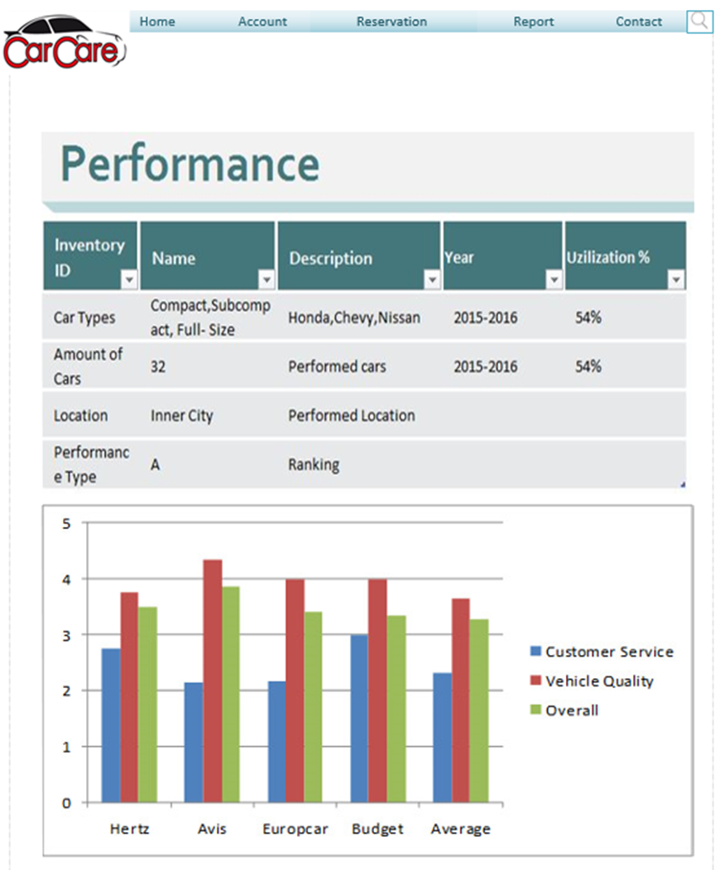
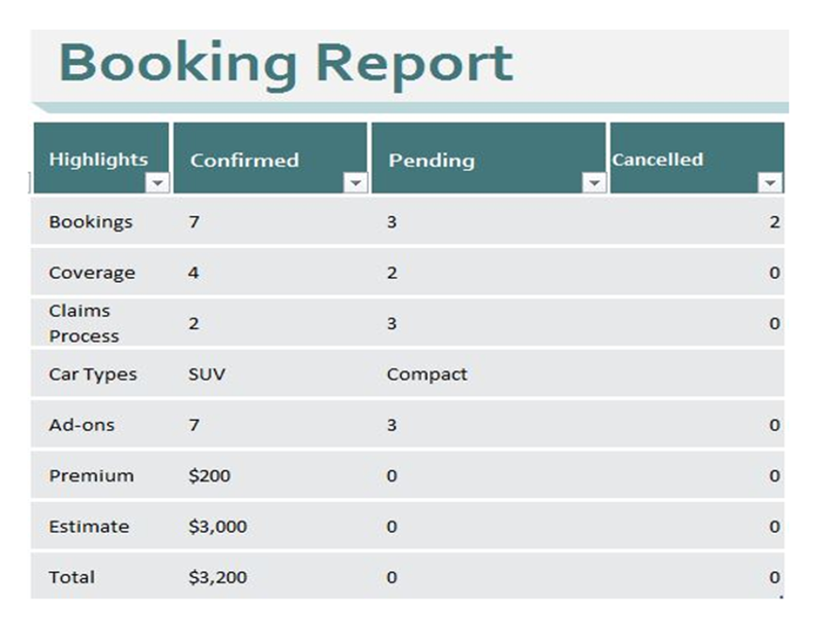
Mock-up UI
Sale Report
Accident Report
Performance Report
Booking Report

Slide 16
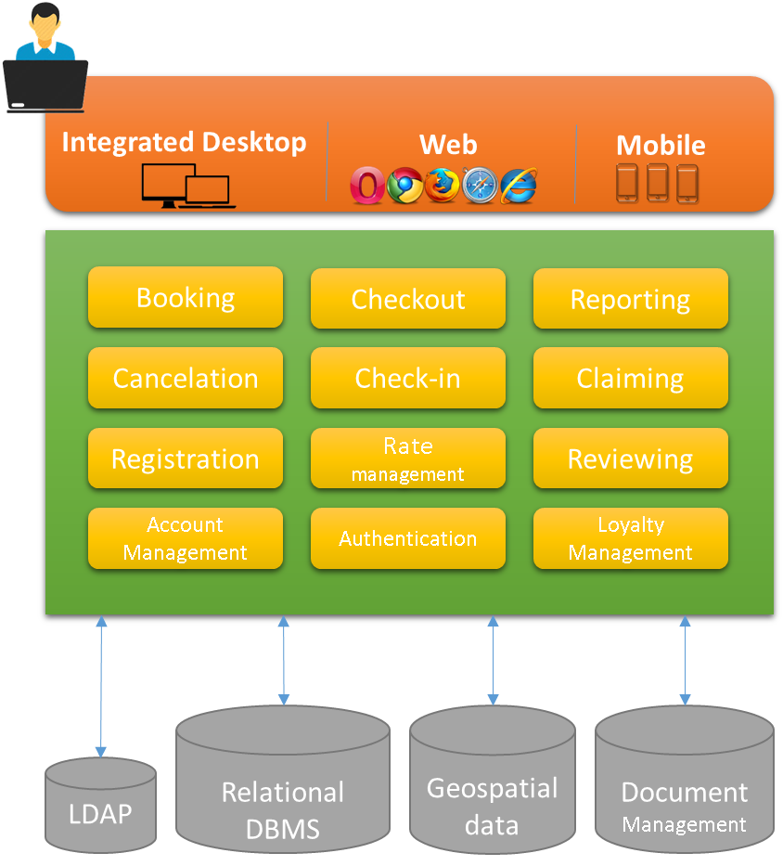
High Level Software
Architecture Diagram

Slide 17
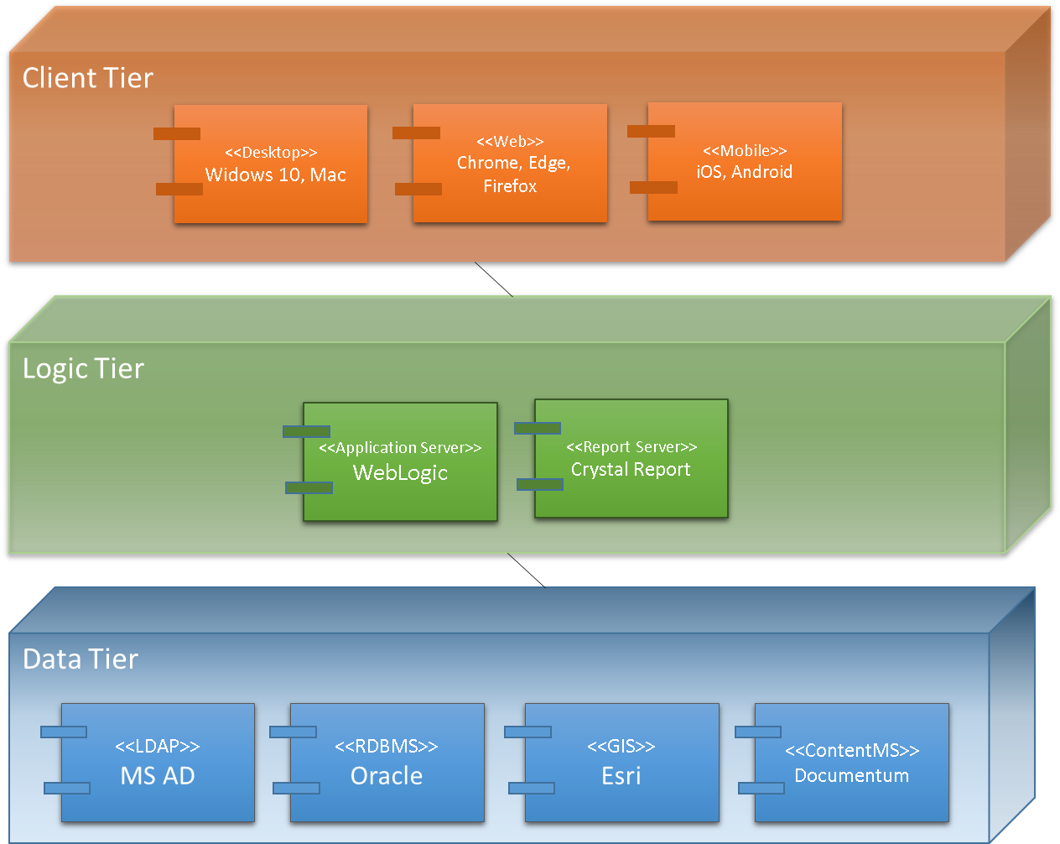
Component & Deployment

